Slide 1

Reverse Engineering
WORKSHOP
Protecting and Breaking the Software
Satria Ady Pradana
Reversing.ID
Revealing the Truth through Breaking Things
https://xathrya.id

Slide 2
# Whoami?
Cyber Security Consultant at Mitra Integrasi Informatika (MII)
Researcher at dracOs Dev Team
Coordinator of Reversing.ID
Member of Indonesia Honeynet Project

Slide 3
Overview
Engage in practical basic reverse engineering activity
Three basic reverse engineering principle.
Common reversing technique

Slide 4
Review the Reversing
What, Why, and How?

Slide 5
The Term
Originally used in the context of mechanical engineering
Breaks down an existing object or system to its construction and then rebuild it based on new demand.
Extracting knowledge or design information from anything man-mad and reproducing it or reproduce anything based on the extracted information.

Slide 6
Fundamental Principle
Comprehension
Gain knowledge of basic principle or mechanics of object, the behavior, and knowledge that might related to subject.
Decomposition
Breaking down the system into its structure and gain insight about inherent structure and properties of the component that make the system.
Reconstruction
Reform or reconstruct the components based on need.

Slide 7
Common Practice
Resource Modification (Modding)
Modify the application resource.
Control Flow Bypass
Alter program flow, force the execution to takes or jump over the intended action.
Code Caving
Writing code to specific region of process.

Slide 8
The Language
Various programming language exists with unique and distinctive characteristic.
Typically, divided into two classes of programming language: native, interpreted.
Native: C, C++, Pascal, Rust, Assembly.
Interpreted: Python, Ruby, Java, .NET

Slide 9
The Executable Format
Application has a format.
Identify by magic number.
Structured and has some sections for data, code, resource, etc.
Function might be provided by foreign module (ex: DLL), list of imported function is maintained.

Slide 10
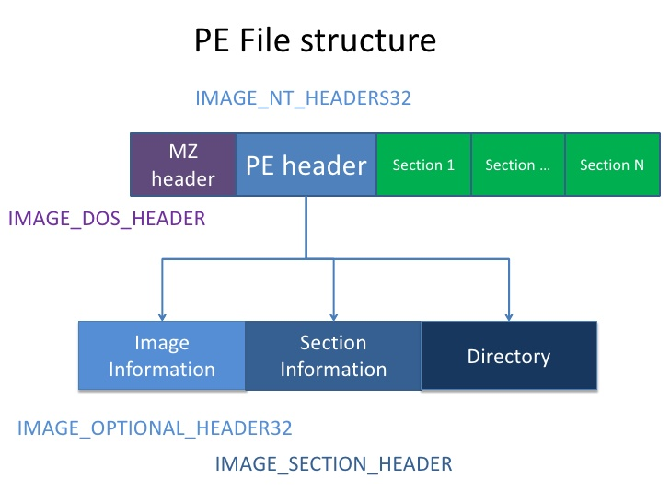

Slide 11
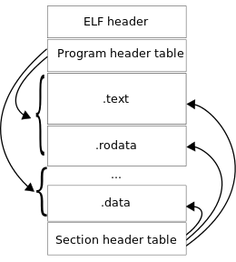

Slide 12
Common Tools
Hex Editor
Disassembler
Debugger
Resource Editor

Slide 13
Our Tools
Radare2
Mono

Slide 14
Our Target
CrackMe.cs
Challenge.cs
Compile them
mcs CrackMe.cs

Slide 15
Dwelling to the New Language
Learning one programming language might speed up learning curve for learning other programming language.
The basic programming syntax you need to know:
Basic type declaration
Control Flow:
Decision (if, switch, etc)
Loop (for, while, etc)
Function
The rest is about language charactestic.

Slide 16
C#
Managed code, interpreted
Run on top of .NET framework
Translated into “bytecode” or some kind of “assembly”
The language is called Common Interpreted Language (CIL)
The interpreter is called Common Language Runtime (CLR)
Very similar to its high level code.

Slide 17
Operations to Know in “Assembly”
Assignment
Load/Store data
Branching (Jump & Call)
Arithmetic
Logical
Language specific feature

Slide 18
Hands On: CrackMe in C#

Slide 19
Task 1: Get Binary Information
$ file CrackMe.exe
$ rabin2 –I CrackMe.exe

Slide 20
Task 2: Disassembler and Assembler the Code
$ monodis CrackMe.exe --output=CrackMe.cil
$ ilasm /exe /output:CrackMe2.exe CrackMe.cil

Slide 21
Task 3: Modify Resource (String)
Disassemble the file
Search for header string, such as “Personalize Crackme for Satria”
Change to exclusive for you, such as “Personalize Crackme for Ady”
Assemble the file

Slide 22
Task 4: Get the Right Password
We are asked for password.
Grab it.
It is hardcoded so you may need to scroll the code.

Slide 23
Task 5: Bypass the Jump
Something happen, our code is stopped. Jump to the next stage, please.
There is a mechanism that checking the condition. See the return value of stage1() and see the required value.

Slide 24
Task 6: Change Target Function
We got the wrong destination, let see if we are able to change it.
Currently we are calling a function stage3() while the function we want is stage3_true()
Change the code to the respective intention.

Slide 25
Task 7: Inject Custom Code
Mayday!
We need code!
Write it by yourself.
The last stage require specific value assigned to access the function. We can create a function to change this value and call it before calling the function.

Slide 26
Challenge

